Slide 1
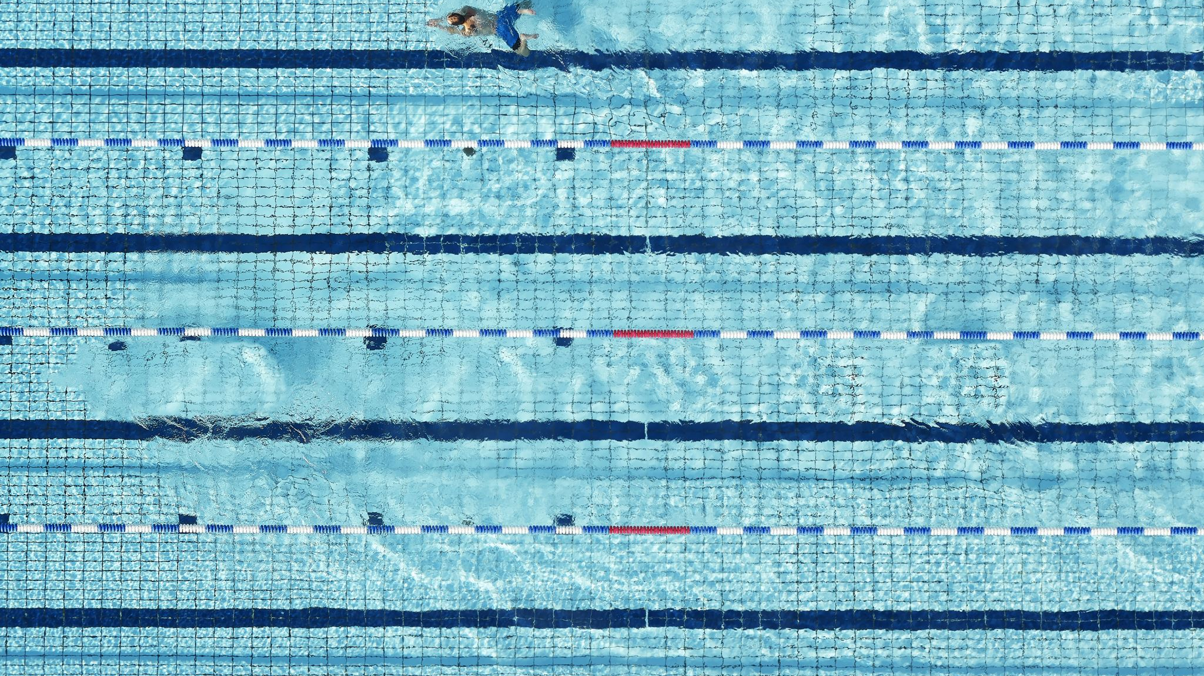
Swimming lifeguard Swimming Teacher Training

Slide 2
What is discuss
Introduction to swimming
History of Swimming
Importance of Swimming
Basic Swimming Skills
The Four Swimming Strokes
How to Become a Swimming Coach
Lifeguard Training
CPR

Slide 3

Introduction to swimming
Individual sport
Olympic sport
Using the arms and legs to move
All ages

Slide 4
History of Swimming
One of the oldest sports.
Competitive swimming started in London
Olympic Games in 1896.

Slide 5
Importance of Swimming
Strengthens all body muscles
respiratory system
Safe for joints
A life-saving skill

Slide 6
Basic Swimming Skills
Straight line
Kicking technique leg
Superman
Bubbles breathing
Floating

Slide 7
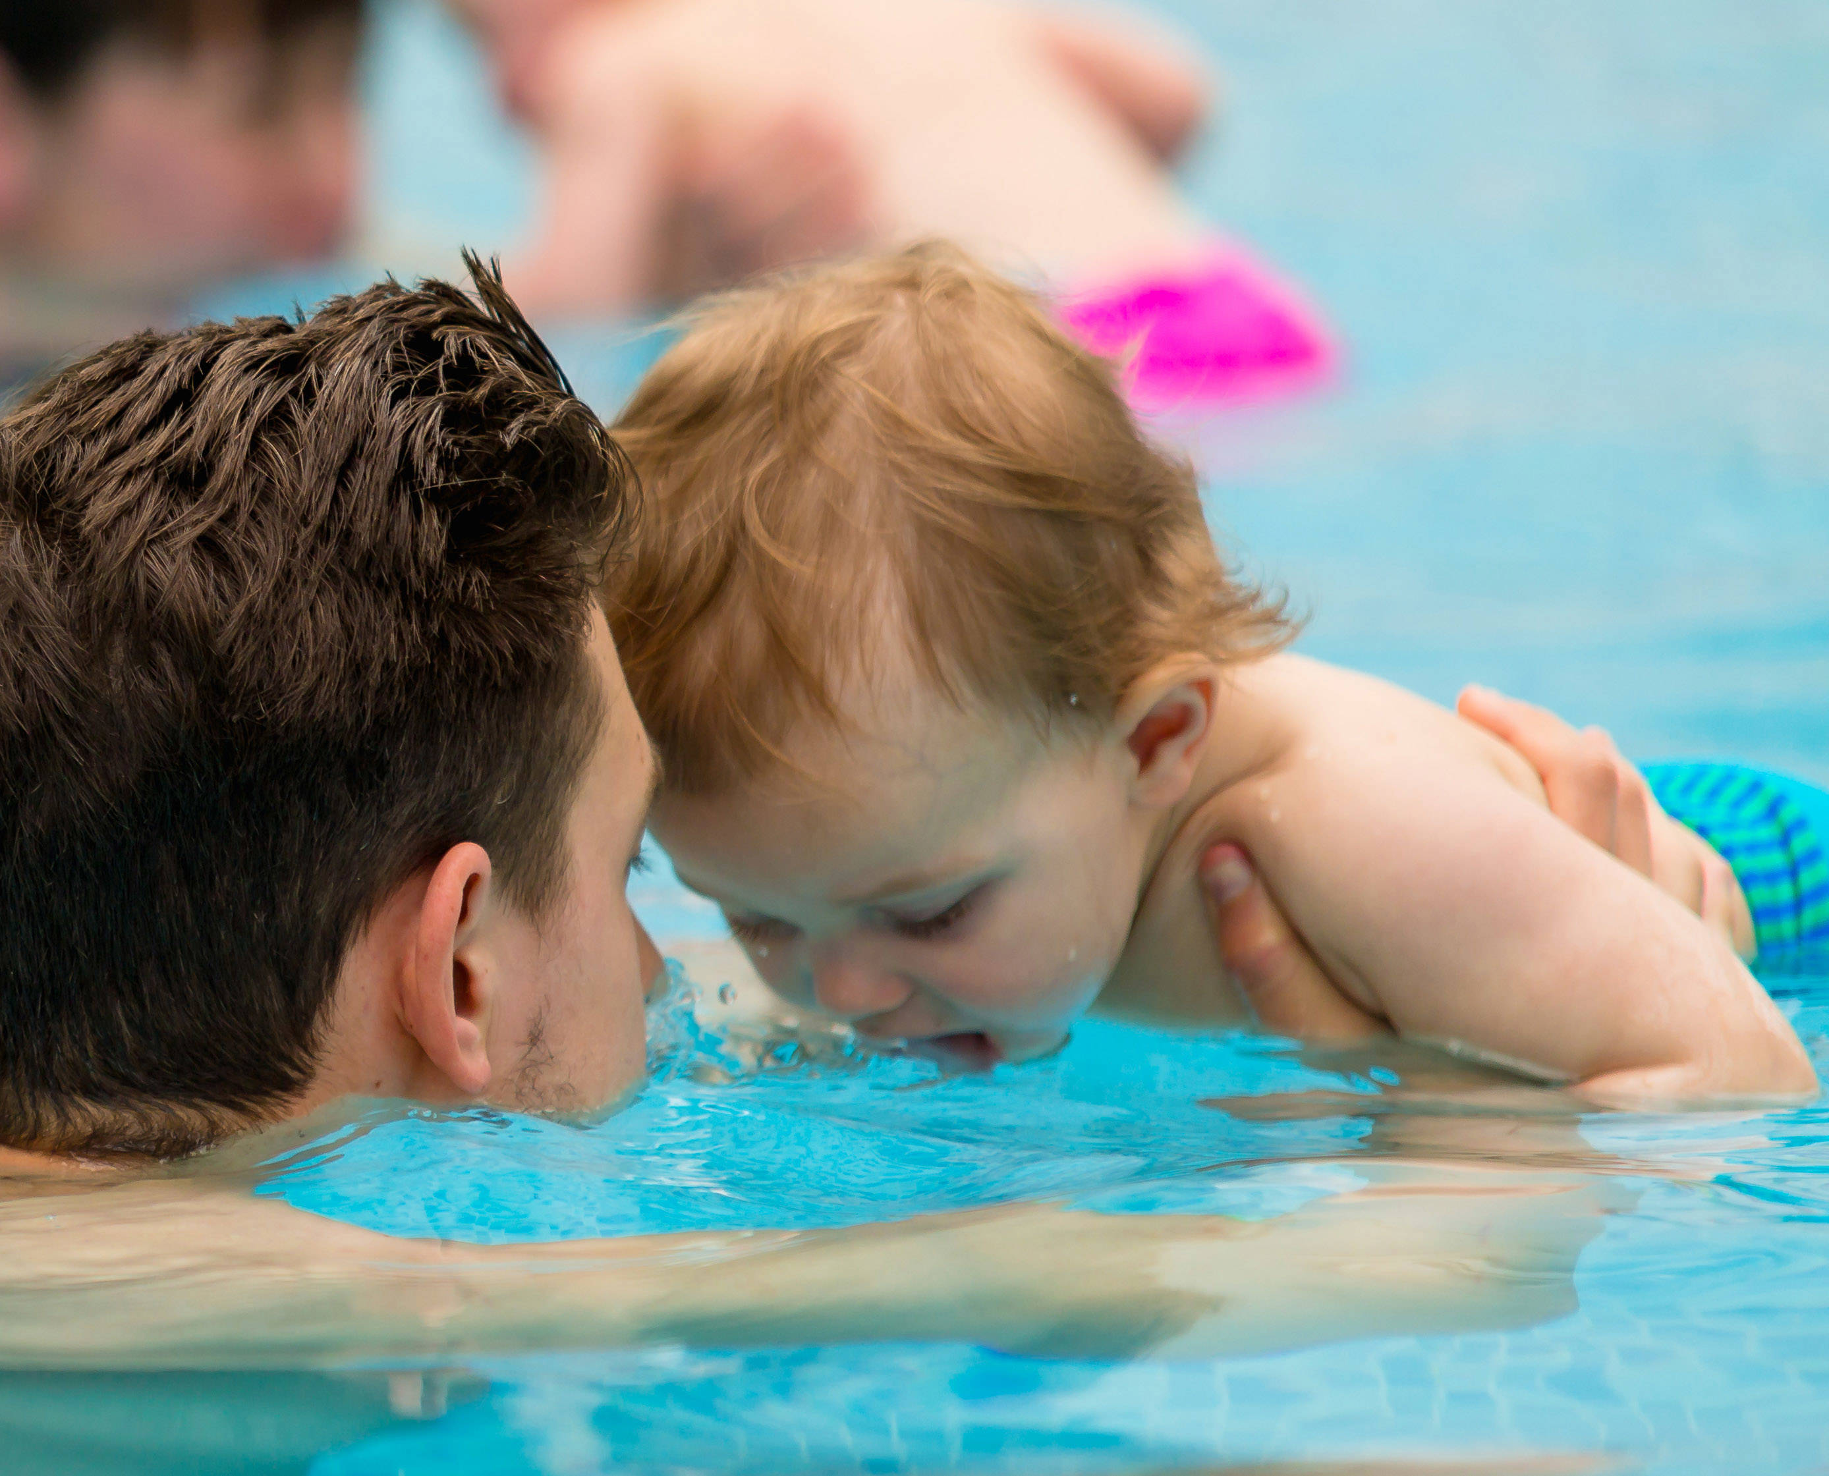
Bubbles breathing

Slide 8
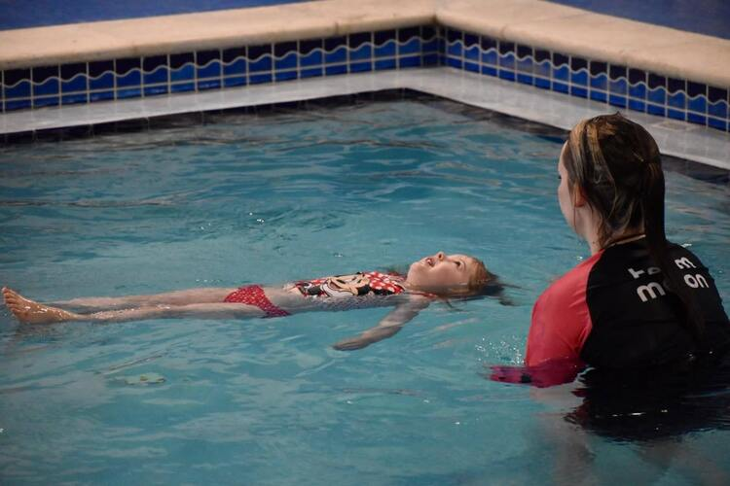
Floating

Slide 9
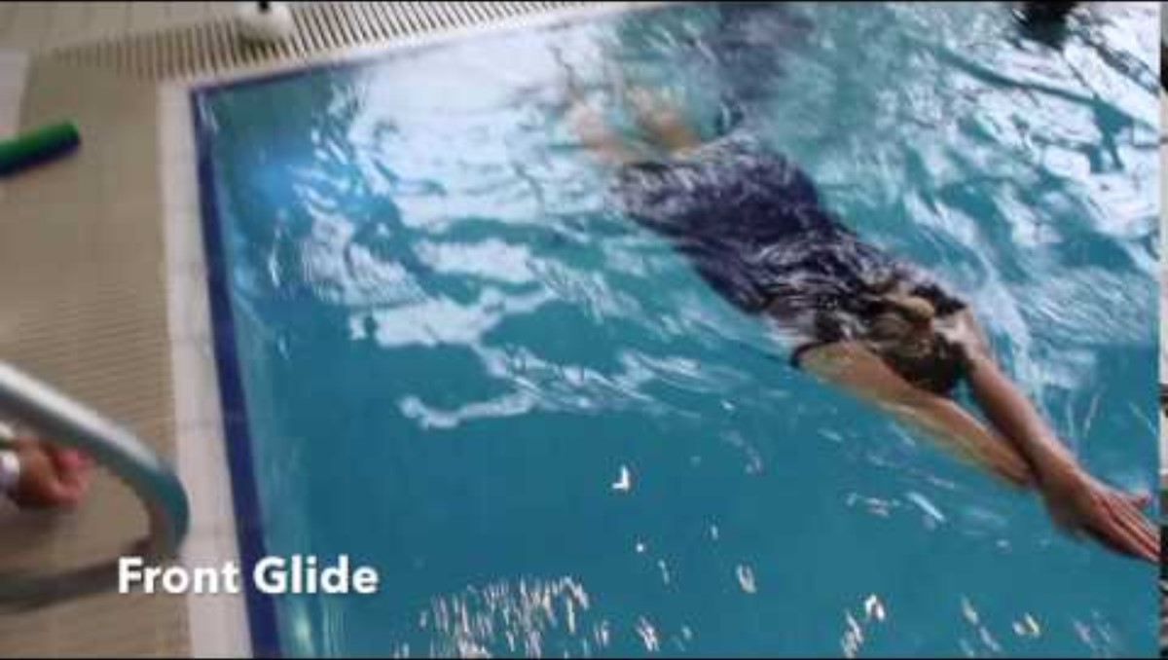
Stright Line

Slide 10
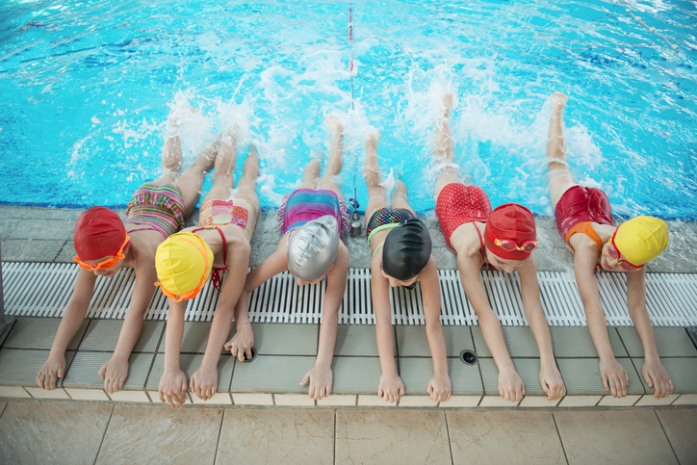
Kicking Technique Leg

Slide 11
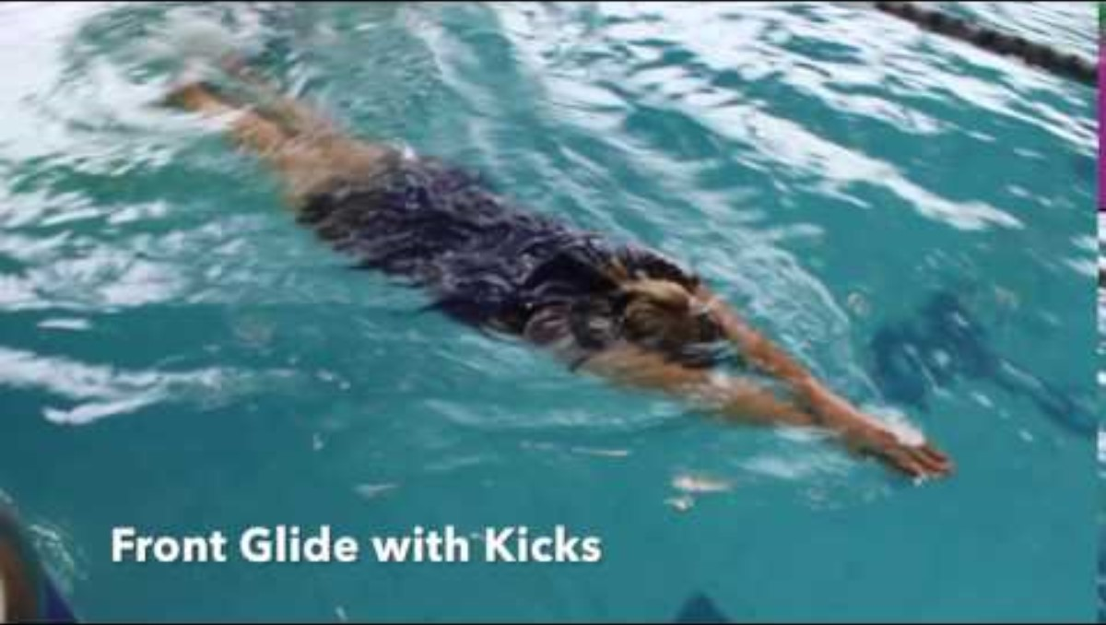
Superman

Slide 12
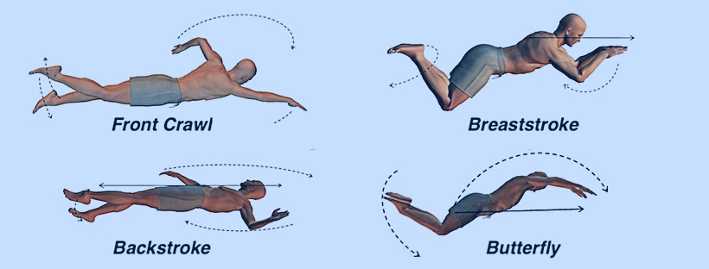
The Four Swimming Strokes

Slide 13
How to Become a Swimming Coach
Master swimming techniques
Complete instructor certification
Study teaching methods
Learn first aid and CPR
Pass official federation tests

Slide 14

Lifeguard Training
Back Breast
Head-Up
Underwater
CPR

Slide 15
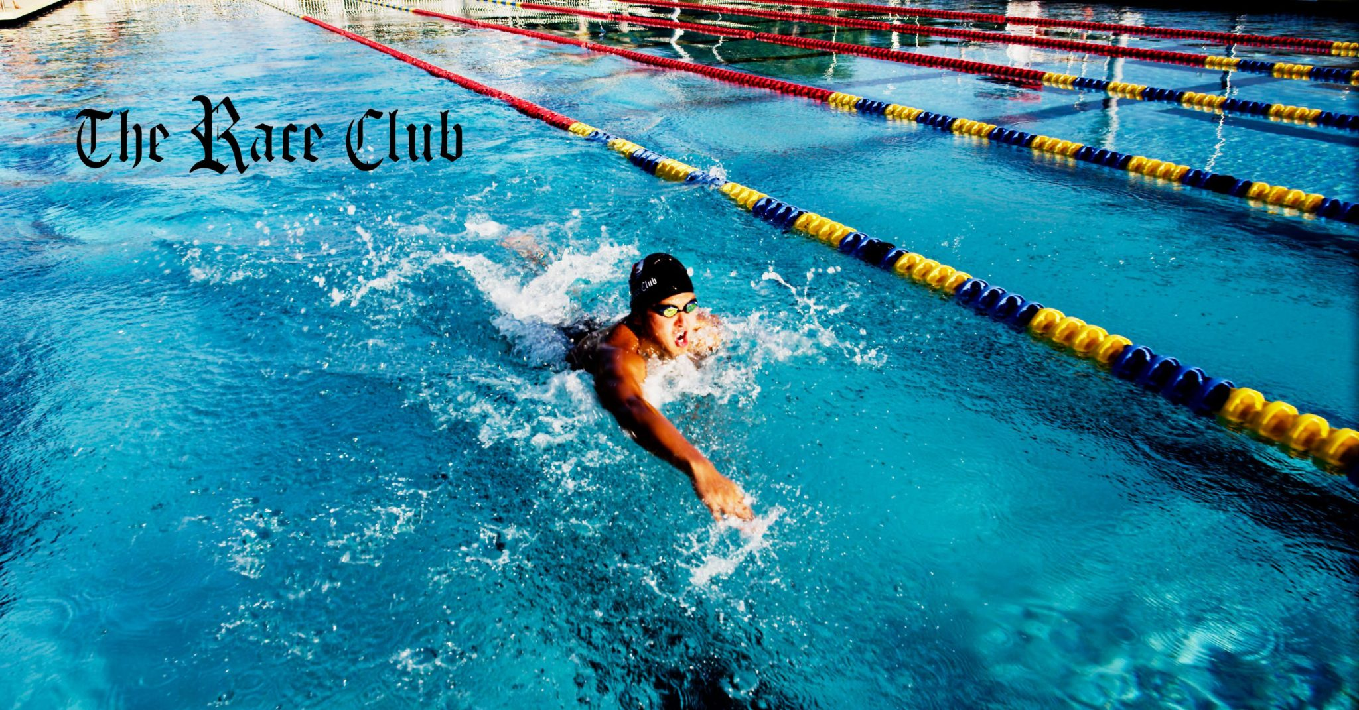
Head-Up

Slide 16
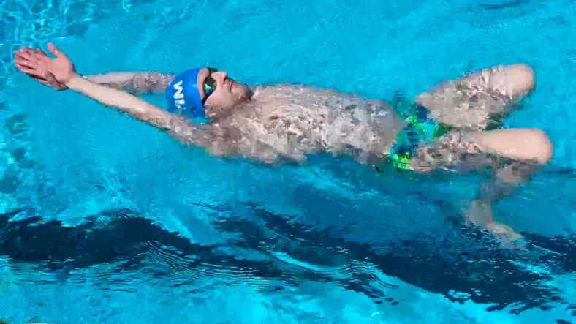
Back Breast

Slide 17
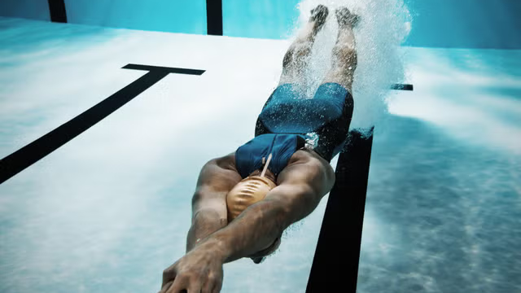
Under water

Slide 18
First Aid (Very Important)
What is First Aid?
First Aid is the immediate care given to an injured or unconscious person before professional medical help arrives.

Slide 19
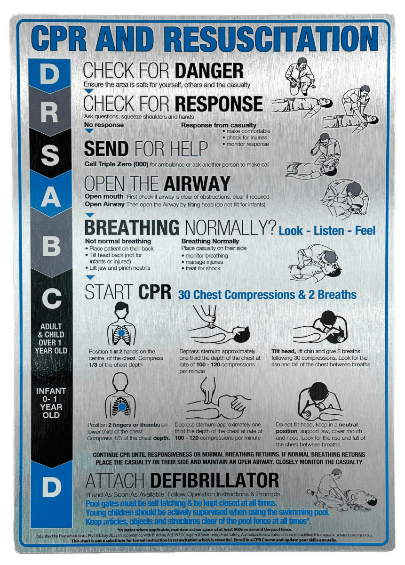

Slide 20
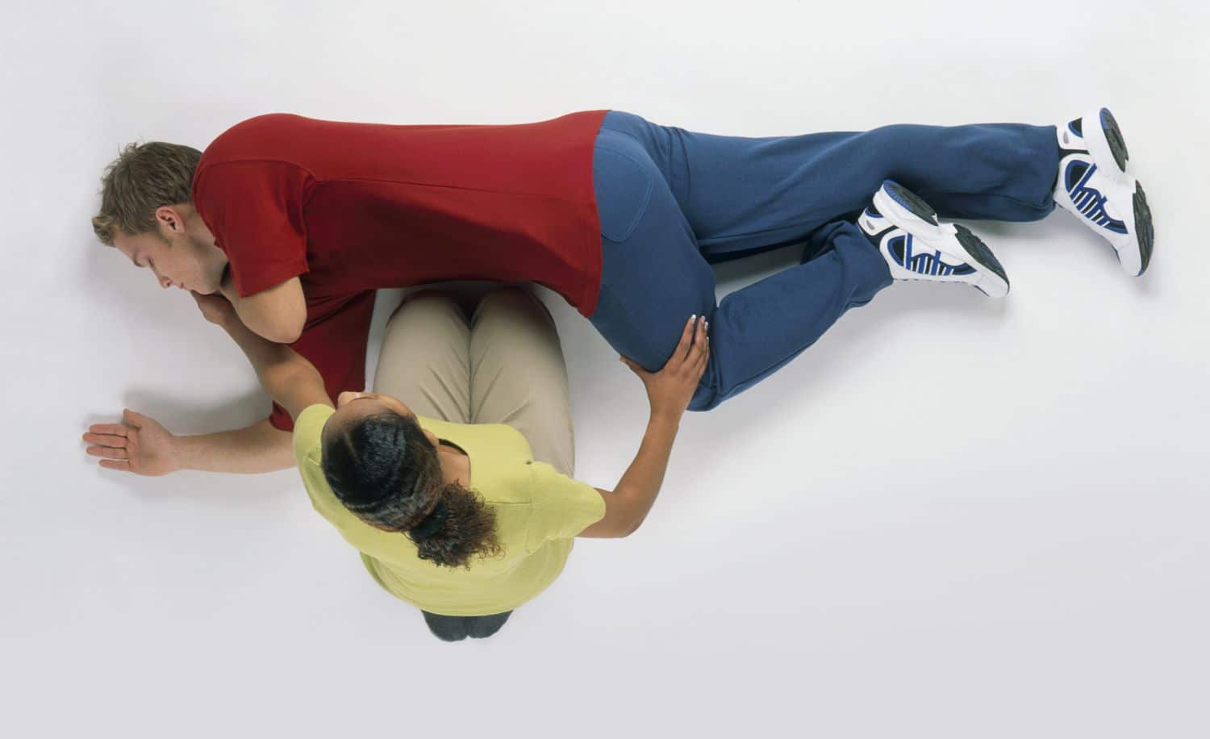
Recovery

Slide 21
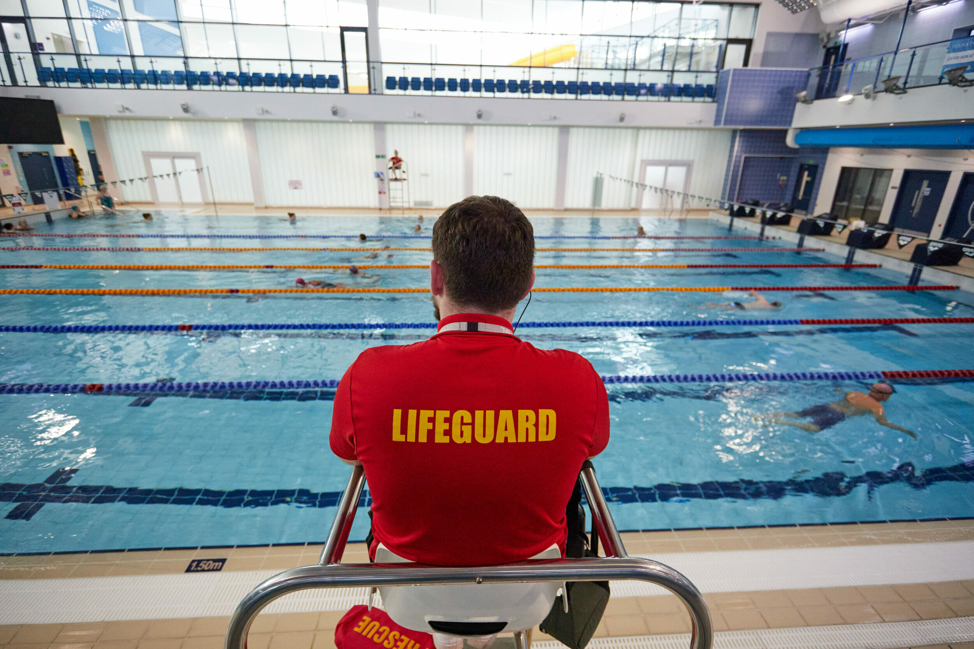
Lifeguard Test
25 Head-Up
25 Under Water
25 Back Breast

Slide 22
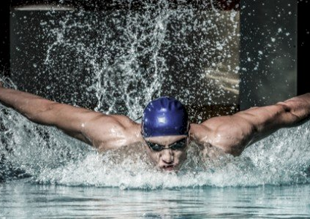
Swimming Teacher Test
100 For All Strokes
25 Dolphin
25 Backstroke
25 Breaststroke
25 Crawl

Slide 23
Conclusion
Swimming is not just a sport. It is a life skill that can save lives.

